Slide 1

Predicting NBA Player Injury Risk from In-Season Workload Patterns
Leo Luera
Project 1, Milestone 3
Notes:
Hello. My name is Leo Luera, and today I'm presenting my Project 1, Milestone 3 work for predicting NBA player injury risk from in-season workload patterns. I’ll be walking through the business problem, how I built and cleaned the data, the modeling approach, what the results actually show, and what I'd recommend doing next.

Slide 2
Business Problem
NBA teams invest heavily in load management and sports science staff, yet they lack a simple, data-driven way to flag which specific players are entering a higher-risk window based on their own recent workload.
The NBA's own analytics group examined roughly 150 players per season from 2014 to 2023 and found no significant correlation between game-participation frequency, schedule density, or cumulative participation and injury.
Research Questions
Can recent workload predict elevated risk in the games that follow?
2. Which workload features are the strongest predictors: minutes, rest, or schedule density?
3. Do the findings support or contradict the NBA’s own conclusion on schedule density?
The goal is to create a model that complements existing load-management practices for team performance staff, rather than replacing their judgement.
Notes:
Let's start with why this matters. NBA teams invest heavily in load management, such as sports science staff, rest days, minutes restrictions — but they still don't have a simple, data-driven way to flag which specific player is entering a higher-risk window based on their own recent workload. Most of what teams do today is based on general policy, not individual signals.
What makes this especially interesting is that the NBA's own analytics group looked at roughly 150 players per season from 2014 to 2023, and found no significant correlation between game frequency, schedule density, or cumulative participation and injury.
That's a pretty surprising, contested finding — it runs counter to a lot of the assumptions behind load management. So, I wanted to independently test that at the player level, using public data.
That led to three research questions: First, can a player's recent workload actually predict elevated injury risk in the games that follow? Second, which workload features matter most — minutes, rest, or schedule density? And third, do my findings support or contradict the NBA's own conclusion?
To be clear about scope: the goal here is not to replace a medical staff's judgment. It's to create a model that complements existing load-management practices — one more data point in the room, not a decision-maker.

Slide 3
Background
Injury risk in professional basketball has become an increasingly prominent analytics topic as teams weigh competitive performance against long-term player health. There are several prior works that inform this project:
Bontemps, T. (2024, January 13). NBA report: No link between load management, less injury risk. ESPN. https://www.espn.com/nba/story/_/id/39288379/nba-report-no-link-load-management-less-injury-risk
Bullock, G. S., Ferguson, T., Vaughan, J., Gillespie, D., Collins, G., & Kluzek, S. (2021). Temporal trends and severity in injury and illness incidence in the National Basketball Association over 11 seasons. Orthopaedic Journal of Sports Medicine, 9(6). https://doi.org/10.1177/23259671211004094
Torres-Ronda, L., Gámez, I., Robertson, S., & Fernández, J. (2022). Epidemiology and injury trends in the National Basketball Association: Pre- and per-COVID-19 (2017–2021). PLOS ONE, 17(2), e0263354. https://doi.org/10.1371/journal.pone.0263354
Wang, E. (2025). Using injury-risk forecasting to quantify financial impact in the NBA. Wharton School, University of Pennsylvania. https://wsb.wharton.upenn.edu/wp-content/uploads/2025/12/WANG_Using-Injury-Risk-Forecasting-to-Quantify-Financial-Impact-in-the-NBA-1.pdf
Three data sources were combined for this analysis, all sourced from Kaggle:
NBA Injuries (2010 – 2020): 27,105 raw transaction records scraped from Pro Sports Transactions, with fields for date, team, player acquired, player relinquished, and a free-text notes field describing the transaction: https://www.kaggle.com/datasets/ghopkins/nba-injuries-2010-2018
NBA Games: 26,651 game-level records (2003 – 2022) with final scores, shooting statistics, and a season label for each game: https://www.kaggle.com/datasets/nathanlauga/nba-games
NBA Games Details: 668,628 player-level box score records (one row per player per game), including minutes played, points, and other box-score statistics, joined to game dates and seasons: https://www.kaggle.com/datasets/nathanlauga/nba-games
Notes:
To build this, I combined three datasets from Kaggle. The first is an NBA injuries dataset covering the 2010 to 2020 NBA seasons — about 27,000 raw transaction records scraped from Pro Sports Transactions, with free-text fields describing player movements. The second and third are NBA game-level and player-level box score datasets spanning 2003 to 2022 seasons — the second has final scores and season labels, the third has over 668,000 player-level rows with minutes played and other box score stats.
Before building this, I looked at what's already been published. The NBA's own report found no clear link between schedule density and injury. Separately, researchers like Bullock and colleagues, and Torres-Ronda and colleagues, have tracked injury incidence and severity across multiple NBA seasons, which gave me useful baseline context for how common these injuries actually are league-wide.
The most directly relevant prior work is Wang's 2025 paper out of Wharton, which built a random forest model on box score and injury data from 2010 to 2022 seasons, using sixteen engineered features, and got around 69% correct classification of next-game injury risk. That became my benchmark and template — though my feature set is narrower, focused specifically on workload and schedule variables.

Slide 4
Data Explanation
Turning free-text transactions into a reliable label
Category | Rows | Action
Raw placed_on_IL entries | 17,560 | Starting point
Non-injury absences (rest, personal, conditioning) | 620 | Reclassified
Coach/staff entries | 14 | Reclassified
Malformed team-as-player entry | 1 | Reclassified
Final injury events used for modeling | 16,935 | Retained
Name normalization raised the player-match rate between datasets from 94.3% to 97.0%.
Notes:
Here's where things got more hands-on. The injury dataset didn't have a clean "this was an injury" flag — it just had free-text fields like "acquired" and "relinquished." Som I had to build that label myself, and it took several rounds of cleaning.
Starting from 17,560 raw "placed on Injury List" entries, I found 620 that were actually just rest days, personal reasons, or conditioning — not real injuries — so those got reclassified. Then I found 14 entries that were actually head coaches' medical leaves mistakenly logged under the player field. And I found one row where a team name had literally been recorded as the player. After excluding all of that, I was left with 16,935 confirmed injury events I could actually trust.
On top of that, I had to match player names across two differently-formatted datasets. After normalizing things like periods in initials and different suffixes, I raised the match rate from 94.3% to 97%. That last 3% is mostly nicknames and international name spelling differences that I spot-checked rather than chased further.

Slide 5
Methods
Five workload signals:
Rolling average minutes (trailing 5 and 10 games)
Cumulative minutes played this season
Days of rest since last game
Team-level back-to-back flag
Back-to-backs in the trailing 5 games
Target: injured_next_7d
A forward-looking binary label: 1 if the player’s next confirmed injury occurs within 7 days after this game. Every feature uses only information known before the game, nothing leaks from the outcome being predicted.
Time-based split, two models, imbalance-aware
Train / Test Split:
Train: 2010 – 2017 seasons
Test: 2018 – 2019 season
Split by season so the model is never evaluated on games that happened before its training data
Two Classifiers:
Logistic Regression (interpretable baseline) and Random Forest (primary model), both using class_weight = balanced
Evaluation:
Precision, recall, F1, and ROC-AUC. Not raw accuracy, given roughly 1 injury-preceding game per 11 healthy ones.
Notes:
With a clean label in place, I built the actual modeling table. The target variable is called “injured_next_7d” — a forward-looking binary flag that's 1 if the player's next confirmed injury happens within 7 days after a given game. Every feature only uses information known before that game, so nothing leaks from the outcome I'm trying to predict.
I engineered five workload signals: rolling average minutes over the trailing 5 and 10 games, cumulative minutes played so far that season, days of rest since the last game, a team-level back-to-back flag, and how many back-to-backs happened in the last 5 games.
For modeling, I trained two classifiers — a logistic regression as an interpretable baseline, and a random forest as the primary model — both using balanced class weighting, since injuries are rare relative to healthy games. And critically, I split the data by season rather than randomly: training on 2010 through 2017 seasons, and testing on the 2018/2019 NBA season. That way the model is never evaluated on games that happened before the data it trained on — which avoids a subtle but serious look-ahead bias.

Slide 6
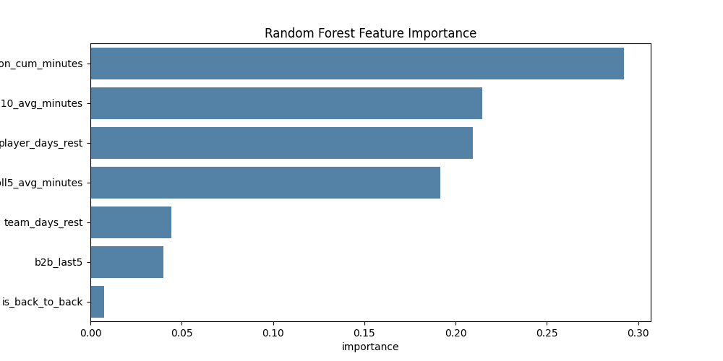
Analysis
Model performance on the held-out test set
Metric | Logistic Regression | Random Forest
Precision (Injury class) | 0.11 | 0.11
Recall (Injury class) | 0.48 | 0.59
F1-score (Injury class) | 0.18 | 0.19
Overall Accuracy | 0.61 | 0.55
ROC-AUC | 0.569 | 0.587
What’s driving the model’s predictions?
Test-set positive rate: 9.0% of games precede an injury withing 7 days
Training-set positive rate: 8.1%
Notes:
So, what did the models actually find? On the held-out test set, the random forest slightly outperformed logistic regression — a ROC-AUC of 0.587 versus 0.569 — with a better balance of precision and recall on the minority injury class. To be upfront: neither model is strongly discriminative. Both are modestly above chance, but well below what you'd call reliable.
Looking at what drove those predictions, cumulative season minutes was the single strongest factor, followed by the 10-game rolling average and days of rest. One thing worth flagging: that same cumulative-minutes variable had an almost negligible coefficient in the logistic regression. My interpretation is that it might partly be acting as a stand-in for "how far into the season is this," since that number rises for basically every player regardless of individual risk — not purely reflecting someone's personal excessive workload.
For context on the numbers: 9% of test-set games preceded an injury within 7 days, versus 8.1% in training — a reasonably stable positive rate across both splits, which gives me some confidence the pattern isn't just a fluke of how I split the data.

Slide 7
Conclusion
A weak, but legitimate signal
RQ1: Recent workload carries detectable but weak signal (AUC 0.57 – 0.59), well below the 0.70 threshold generally considered clinically useful.
RQ2: Cumulative workload and rest patterns matter most; back-to-back scheduling contributes comparatively little.
RQ3: Findings reinforce the NBA’s own conclusion that schedule density has little direct link to injury.
Notes:
So, bringing it back to the three research questions I opened with. On RQ1: recent workload does carry a detectable signal, but it's weak — an AUC of 0.57 to 0.59 is well below the 0.70 threshold generally considered clinically useful.
On RQ2: cumulative workload and rest patterns mattered most; back-to-back scheduling barely moved the needle.
And on RQ3: these findings actually reinforce the NBA's own conclusion — that schedule density alone doesn't have a strong direct link to injury.
I want to be clear that I don't see this as a disappointing result. It's an honest, independently-derived finding that lines up with what the league's own analytics group already published. Workload alone is clearly not the whole picture — which makes sense, since injury is influenced by so much more than just playing time: age, prior injury history, biomechanics, even chance. That's exactly where I’d recommend to take this next — adding prior injury history is the most obvious, well-supported next step.
Thank you for your time.

